Slide 1
Open Collector Gates

Slide 2
Homework #3 (Logic Gates)
Q: Hello, I have nearly finished testing all my logic gates. However, my other gates worked fine on my voltmeter but, gate 74LS03 is unresponsive. As I'm typing this email, I'm testing my 74LS02 again on my voltmeter and it is working correctly. Is there an explanation for why this may be happening to my 74LS03 gate?
A: Congratulations, you've gotten far enough in your homework to find out that "open-collector" gates behave differently than other gates. (That's one reason I put it last in the list of gates to test.) I will explain everything in class tomorrow, so don't worry about it. You'll know exactly how to test the 74LS03 after tomorrow's lecture.

Slide 3
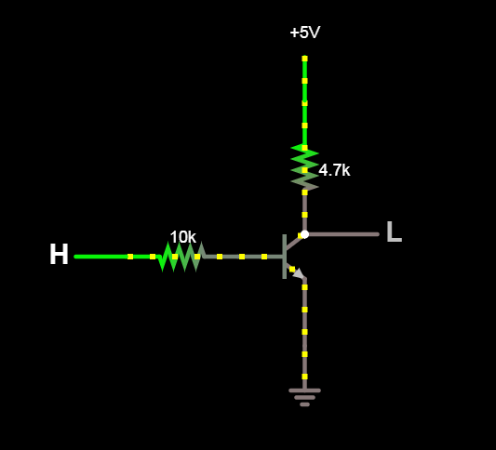
Simple Inverter Gate
Falstad Circuit Simulator

Slide 4
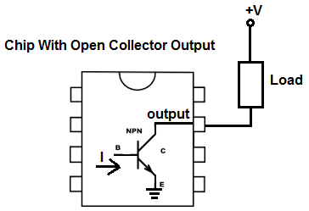
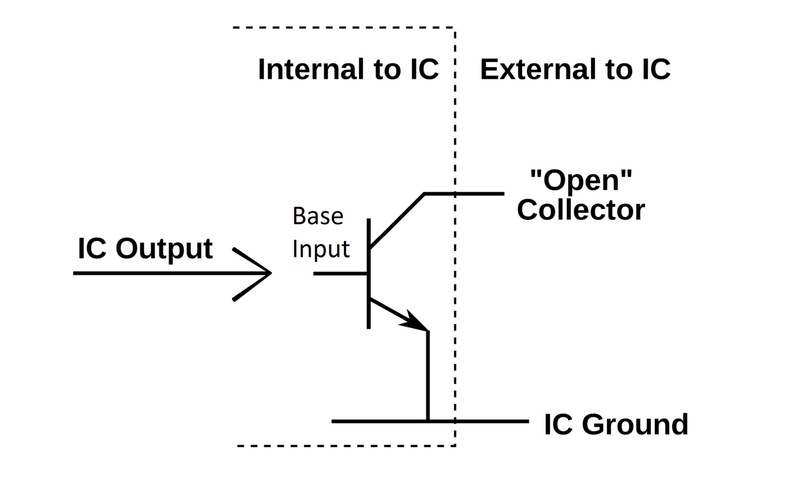
Open Collector Output

Slide 5
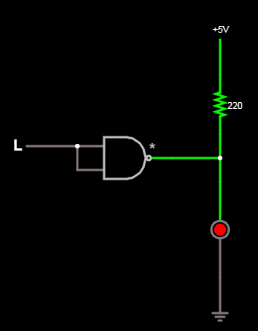
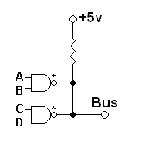
Open Collector Usage

